Slide 1
HIV RAPID TESTING PT PROGRAMME IN ZIMBABWE
Lydia Tongowona, Public Health Specialist
CDC Zimbabwe
Wednesday, June 5, 2024

Slide 2

HIV DTS Proficiency Test (PT) Overview
2017 Inception
Facility Based with Harare Facilities
2018
Transitioned 300 Testers from Facility Based Testing .
2019
2500 testers in 40 Districts
2020
4000 testers in 43 Districts
3000 testers in 40 Districts
2022
2023
Merging of HIV DTS and RTRI into one scheme.
2024
Merging of HIV DTS, RTRI, Syphilis and Hepatitis- Combined DTS One Stop Shop.
Key:
GREEN - PEPFAR
YELLOW – GLOBAL FUND
Notes:
Facility based HIV DTS Inception in 2017,
Country transitioned to tester based PT in 2018, initial 300 Testers
Number increased to 4000 by 2022
Current efforts, merging HIV, Syphilis, Recency and Hepatitis

Slide 3
National Rapid HIV PT Program: Roles and Responsibilities of Multiple Stakeholders
Stakeholders
Roles
MOHCC
Provides policy and regulation
National Microbiology Reference Laboratory (NMRL)
Coordinates EQA( HIV rapid PT samples production, distribution, feedback and corrective actions
EQA Technical Officer
Responsible for PT production, PT distribution and PT results release.
RTCQI Officer
Coordinates RTCQI trainings, supports tester certification and corrective actions
District Lab Mentors
Ensure distribution of PT samples and return of results and CAPA.
District Focal Person (DFP) L ab
Oversees PT program at district level
Nurse-in-Charge
Ensure PT participation, results return and CAPA
Testers
Participates in PT and corrective action when needed
IST riders-
Distribution of PT samples and results to the clinics.

Slide 4
National PT Program Ownership and Sustainability
SURVEY OPENED
SHIPMENT OF SAMPLES
RUNNING OF SAMPLES
SUBMISSION OF RESULTS
ANALYSIS OF RESULTS
FINAL REPORTS ISSUED
REVIEW OF FINAL REPORTS
CORRECTIVE ACTION
COMMUNICATION
FUNCTIONAL EQA DESK
PASSWORD ASSISTANCE
RESULT QUERY
EQA CALENDAR
CORRECTIVE ACTION SUPPORT
National Reference Microbiology Laboratory

Slide 5
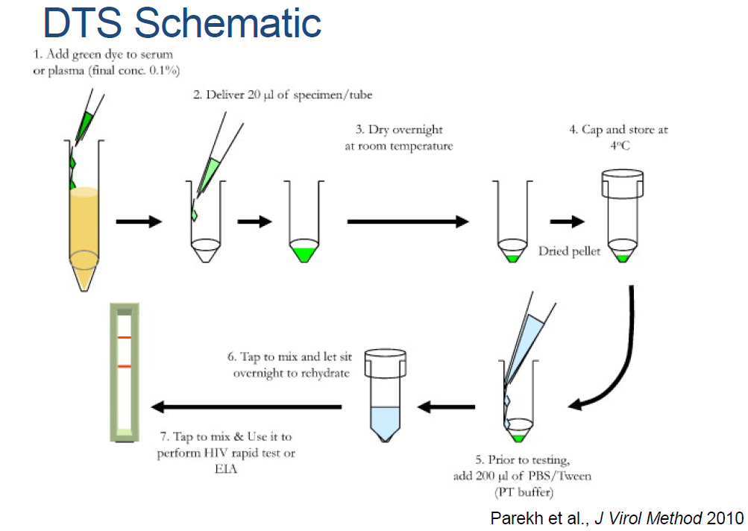
Integration of Proficiency Testing Panel Production
Rapid HIV
Recency
Syphilis
Hepatitis B
Pilot stage

Slide 6
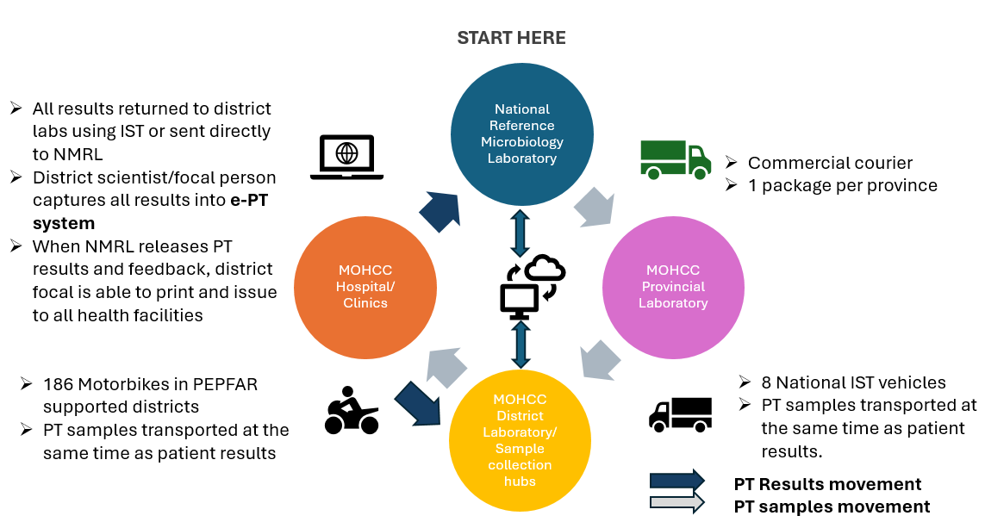
Zimbabwe Relies on Integrated Sample Transport for Distribution of PT Samples and Results

Slide 7
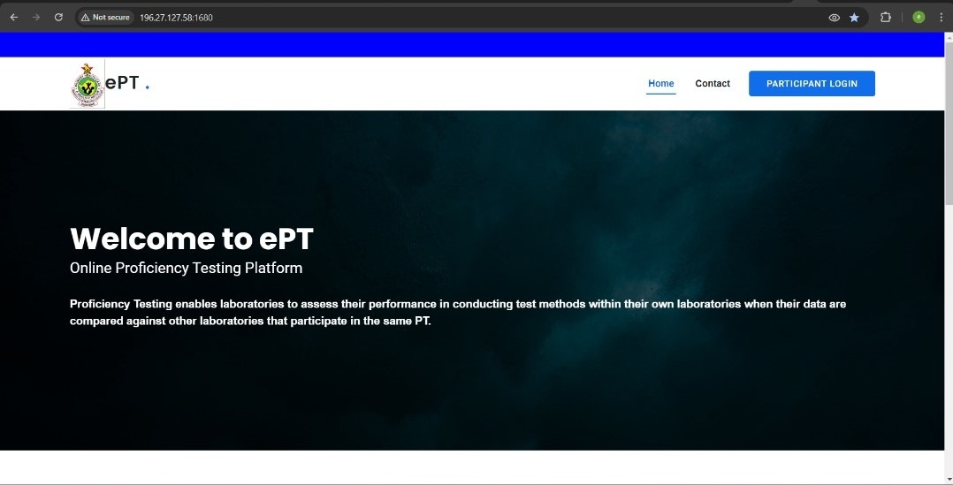
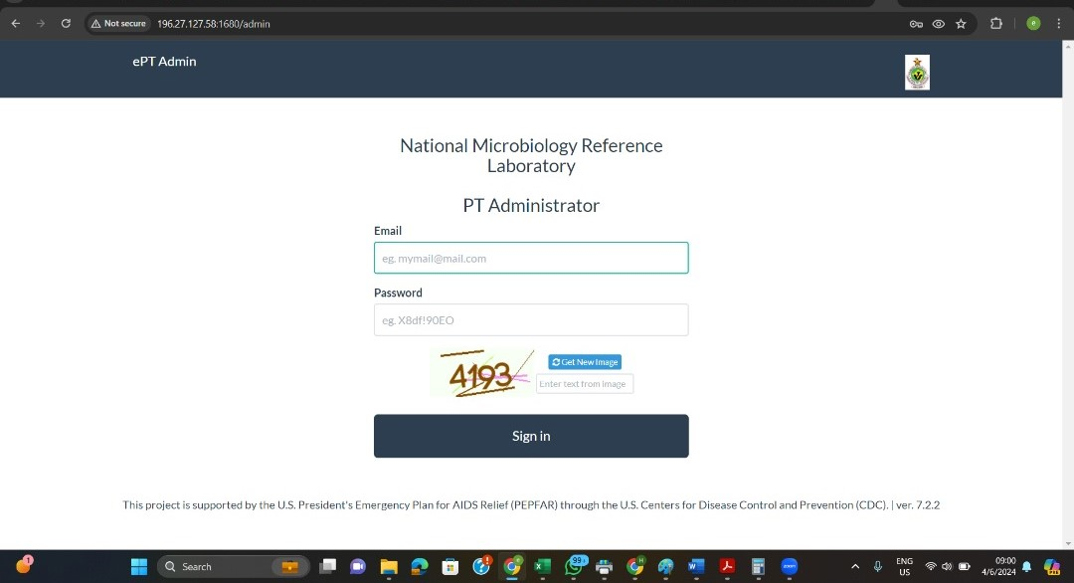
E-Tool for Management of Rapid HIV PT Data
Notes:
Landing page e-PT

Slide 8
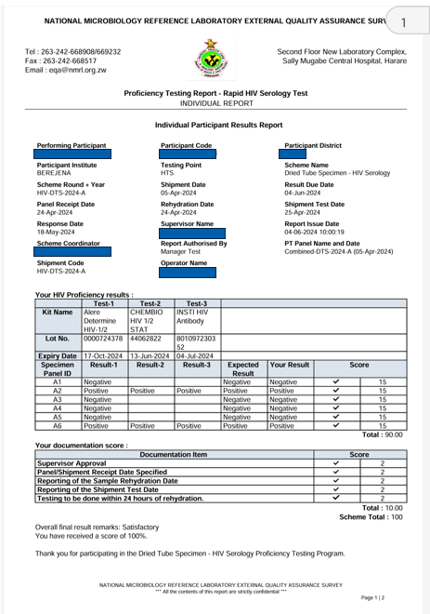
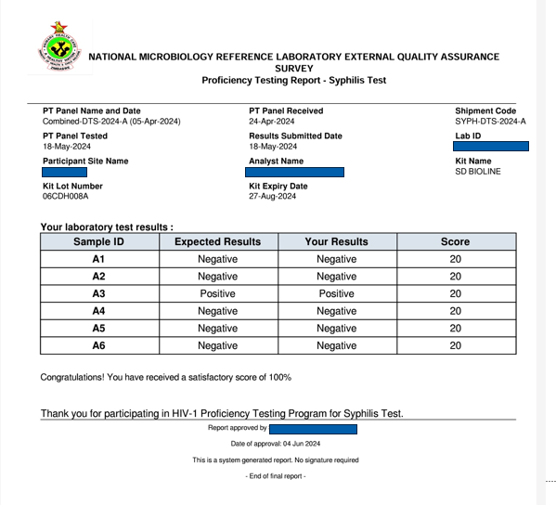
Examples of PT Reports

Slide 9

PT Results Management
Marking scheme is embedded ePT portal. System marks the results and reports are generated.
An EQA review team analyses survey findings before final authorization of reports.
DFPs download reports and send to testers using IST.
Testers test and submit result forms to the DFPs
DFPs enter results into the ePT portal. Entered results are sent to the NMRL for Quality Control of entered data.

Slide 10
Rapid HIV DTS PT Performance 2017 - 2023

Slide 11
Rapid HIV Proficiency Testing Scale up plans
Current
NMRL 4000 testers
ZINQAP 2500 testers.
Tester Gap 1500
Automate PT
Production
ISO17043 accreditation
Dual . HIV DTS and RTRI PT in 2023.
Integration of Hepatitis and Syphilis PT
Pilot PT one district in 2023.
Increase PT Coverage to 100% by 2025
Capacitate the NMRL for increased production.
Decentralise CAPA
Private Sector involvement
ZINQAP has capacity to provide PT for Private Labs.

Slide 12
Lessons Learned
PT integration allows multi-disease monitoring- Syphilis, hepatitis , Recency and rapid HIV
Introduction of district level CAPA has improved quality and completion CAPA
Participation in PT increase tester competency, and quality of HIV testing services
PT Management under MOHCC NMRL sustainable and cost efficient
Automation of PT and IQC production will enable scale up of PT and IQC
Using IST has improved PT distribution and results return TAT

